Slide 1
KPMG Task -3 Presentation on
Sprocket Central Pty Ltd Data Set

Slide 2
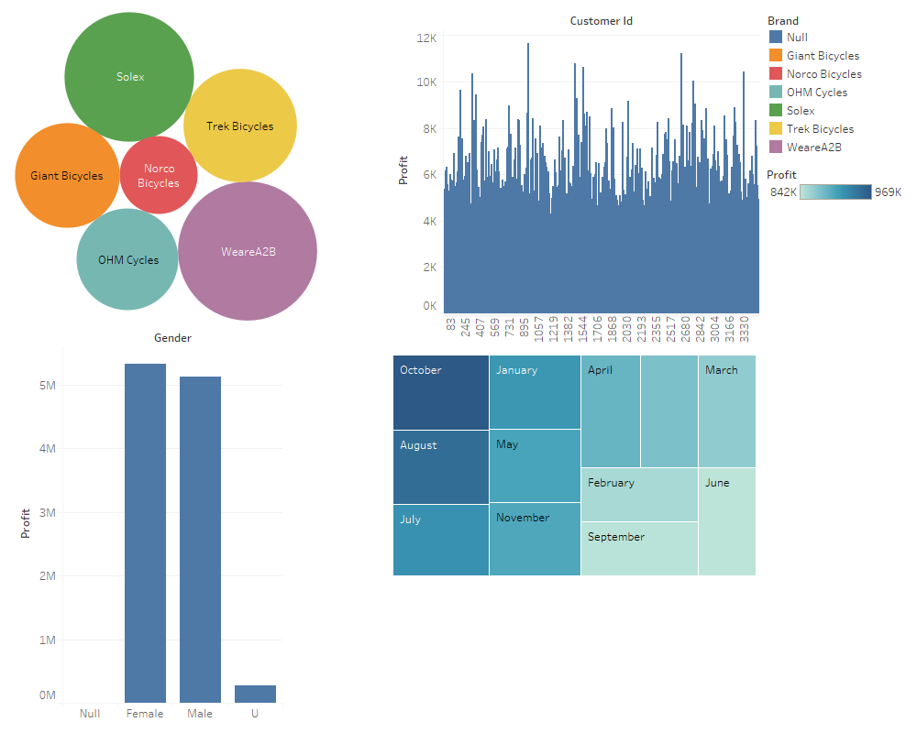

Slide 3
Explanation on above Profit Dashboard Image
Image1 shows the Profit of Brands in Dollars in terms of Packed bubble diagram by using Tableau
Image2 Shows the profit in terms of all customers id’s in bar chart diagram by using Tableau
Image3 Shows the profit in term of Genders by using Tableau.
Image4 Shows the profit in terms of monthly using Treemap in Tableau

Slide 4
From the above Profit Dashboard we Conclude that :
Solex Brand has highest Profit Margin.
All the customer ID are unique and profit are not same for all.
Females has more Profit than male.
Finally October Month has the highest Profit in all Months of the year.

Slide 5
Thank You

